Slide 1




NEXT GEN EMPLOYABILITY PROGRAM
Creating a future-ready workforce
Team Members
College Name
Student Name : Antony Raja.G
Student ID :au951221104004
JP College Of Engineering

Slide 2

CAPSTONE PROJECT SHOWCASE
Project Title
Voting Web Application using Django Framework
Abstract | Problem Statement | Project Overview | Proposed Solution | Technology Used | Modelling & Results | Conclusion

Slide 3
Abstract
By harnessing Django's capabilities, our voting web application fosters inclusivity in digital democracy. Through accessible design and user-friendly interfaces, individuals of diverse backgrounds and abilities can seamlessly engage with the electoral process. Moreover, the application's adherence to accessibility standards ensures that all users, including those with disabilities, can fully participate in polls and exercise their democratic rights. This commitment to inclusivity promotes equitable access to voting opportunities, advancing the principles of fairness and representation in the digital age.
Developed on Django, our voting web app simplifies democratic engagement. Users easily register, browse polls, and cast votes securely. Django's robust framework ensures scalability and data integrity, maintaining user privacy. With intuitive UI/UX design, navigating the platform is effortless, enhancing user experience. Real-time updates and result displays foster transparency, promoting trust in the electoral process. Empowering civic participation, our app revolutionizes digital democracy.
Source :

Slide 4
Problem Statement
Accessibility and User-Friendliness: Many current voting systems lack accessibility features, making it challenging for individuals with disabilities to participate effectively. Additionally, complex interfaces and procedures deter users unfamiliar with technology, further reducing voter engagement.
Integrity and Security Concerns: The integrity and security of online voting platforms remain a significant concern, with vulnerabilities to hacking, manipulation, and tampering. Without robust security measures in place, voters may lack confidence in the reliability and accuracy of digital voting systems.
Real-Time Updates and Transparency: Transparency in electoral processes is essential for fostering trust among voters. However, the absence of real-time updates and transparent reporting mechanisms in existing voting systems
Source :

Slide 5
Project Overview
Accessibility and User-Friendliness: Many current voting systems lack accessibility features, making it challenging for individuals with disabilities to participate effectively. Additionally, complex interfaces and procedures deter users unfamiliar with technology, further reducing voter engagement.
Integrity and Security Concerns: The integrity and security of online voting platforms remain a significant concern, with vulnerabilities to hacking, manipulation, and tampering. Without robust security measures in place, voters may lack confidence in the reliability and accuracy of digital voting systems.
Real-Time Updates and Transparency: Transparency in electoral processes is essential for fostering trust among voters. However, the absence of real-time updates and transparent reporting mechanisms in existing voting systems can lead to doubts about the legitimacy of electoral outcomes.
Source :

Slide 6
Proposed Solution
.
Another crucial aspect to consider for the voting web application is to implement measures to prevent fraud and ensure the fairness of the voting process. This can include features such as:
Voter Verification: Implement a robust voter verification process to ensure that only eligible voters can participate in the elections. This could involve verifying voter identities through official documents or other secure means.
Secret Ballot: Ensure that the voting process maintains the secrecy of each voter's choices. Implement cryptographic techniques to
Source :

Slide 7
Another term for "Trustworthy Governance" in the context of electoral procedures could be "Transparent Administration". This phrase highlights the emphasis on openness, accountability, and integrity in managing the electoral process, which ultimately fosters trust and confidence among participants and observers.
Advantages
Increased Participation: Accessibility from any internet-connected device facilitates broader engagement in the voting process.
Efficient Development: Leveraging Django framework expedites development cycles, optimizing resource utilization.
Robust Security: Integration of encryption and authentication protocols ensures the protection of voter data, mitigating risks of tampering or intrusion.
Trustworthy Governance: Real-time result tracking and transparent reporting cultivate trust in electoral procedures, bolstering confidence in democratic practices.
Source :

Slide 8
"Legal and Regulatory Challenges" could also be described as "Compliance Complexity". This term encapsulates the intricate nature of adhering to various legal requirements and electoral regulations, emphasizing the potential difficulties and delays associated with ensuring full compliance while implementing the voting web application.
Disadvantages
Vulnerabilities to Cyber Attacks: Despite security measures, online platforms remain susceptible to hacking or data breaches, compromising the integrity and confidentiality of voter information.
Digital Exclusion: Dependence on internet access excludes individuals without reliable connectivity or technological literacy, perpetuating disparities in democratic participation.
Potential for Technical Glitches: Complexities in web application development may lead to bugs or system failures, disrupting voting processes and eroding user trust.
Legal and Regulatory Challenges: Compliance with diverse legal frameworks and electoral regulations poses logistical hurdles and may delay or impede the implementation of the voting web application.
Source :

Slide 9

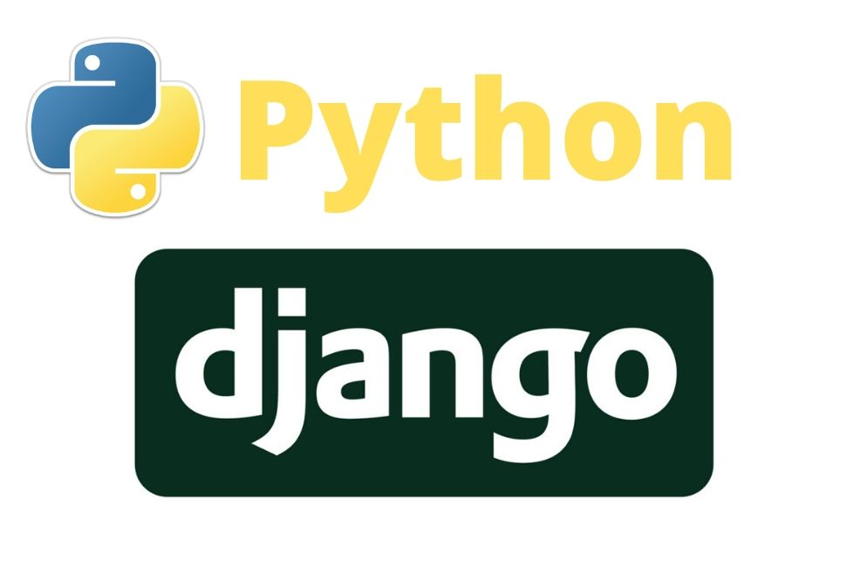

Technology Used
Frontend
Backend
Source :

Slide 10
Modelling & Results
Continuous Monitoring" can also be referred to as "Dynamic Surveillance". This term underscores the active and adaptive nature of monitoring system performance and user interactions, highlighting the ongoing analysis for enhancements and optimizations to ensure the voting platform operates efficiently and securely.
Data Modelling: Employ Django's ORM to structure data efficiently, optimizing storage and retrieval of user, poll, and voting data.
Algorithm Implementation: Develop algorithms for vote processing and result calculation, ensuring accuracy and responsiveness in displaying real-time outcomes.
Validation and Testing: Conduct thorough testing to validate model functionality and algorithm accuracy, addressing any discrepancies or errors to maintain data integrity.
Continuous Monitoring: Deploy monitoring tools to track system performance and user interactions, facilitating ongoing analysis for improvements and optimizations.
Source :

Slide 11
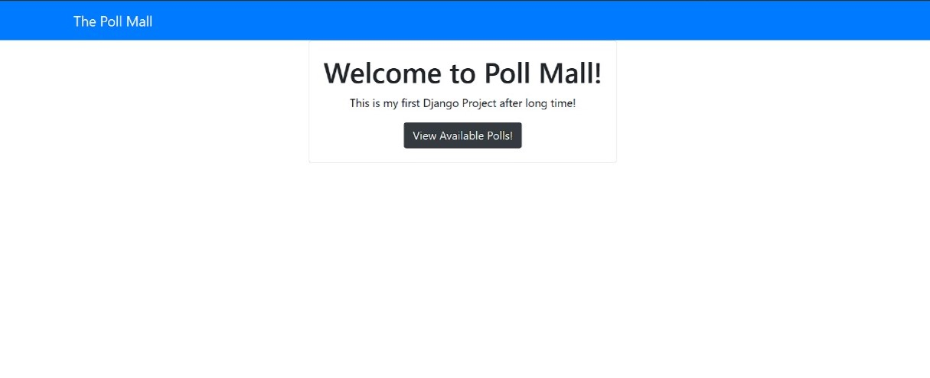
Homepage

Slide 12
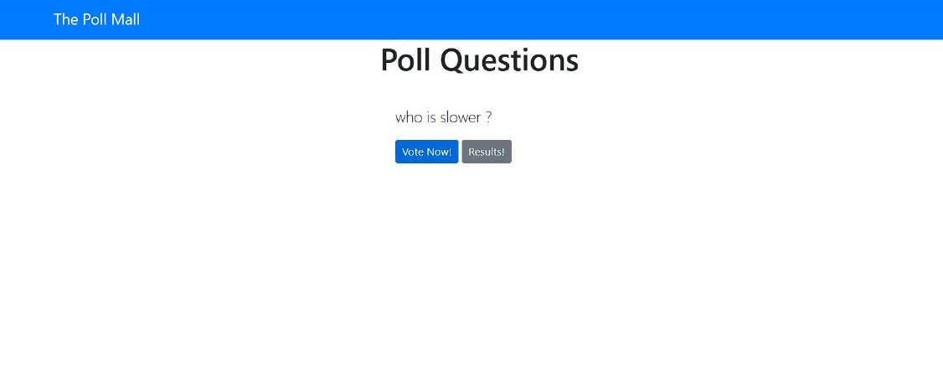
Polling questions page

Slide 13
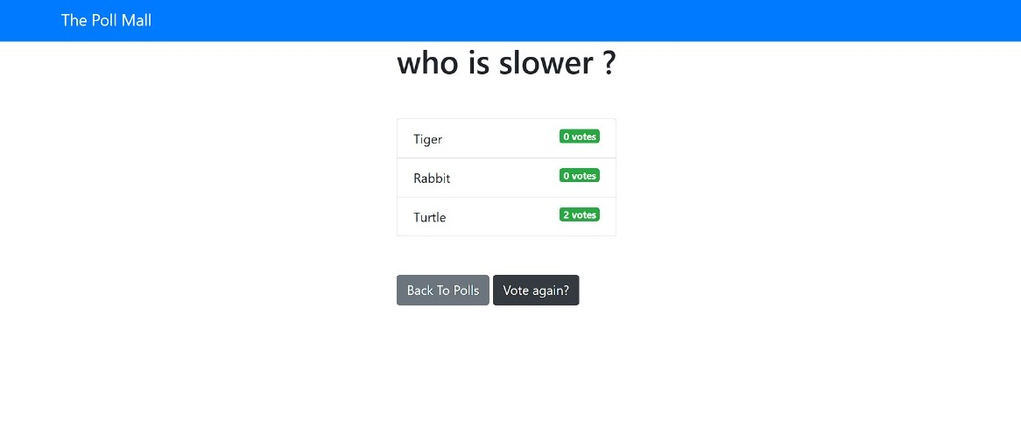
Voting page

Slide 14
Future Enhancements:
"Gamification Elements" could alternatively be described as "Incentive Mechanisms". This term emphasizes the use of game-like elements to motivate participation and encourage community engagement within the voting platform, highlighting the strategy of providing rewards or incentives to users for their involvement.
Integration of Blockchain: Explore incorporating blockchain technology for enhanced security and transparency in the voting process.
AI-Powered Personalization: Implement AI algorithms to tailor user experiences, offering personalized recommendations and notifications.
Mobile Application Development: Expand accessibility by developing dedicated mobile applications for seamless voting on smartphones and tablets.
Gamification Elements: Introduce gamification features to incentivize participation and foster community engagement in the voting platform.

Slide 15
Conclusion
In summary, the development of a voting web application using the Django framework offers a promising pathway to modernize electoral processes. By emphasizing accessibility, security, and transparency, our goal is to enable citizens to actively engage in democratic decision-making. While challenges such as technical intricacies and regulatory adherence must be addressed, the potential benefits of heightened participation and confidence in governance are significant. Ongoing refinement through testing, monitoring, and iterative enhancements will be crucial to ensuring the platform's efficacy and trustworthiness. Ultimately, by embracing innovation and employing technology responsibly, we can advance democratic principles of inclusivity, accountability, and civic empowerment in the digital era.
In conclusion, the development of a voting web application using the Django framework presents a promising avenue for modernizing electoral processes. By prioritizing accessibility, security, and transparency, we aim to empower citizens to actively participate in democratic decision-making. While challenges such as technical complexities and regulatory compliance must be navigated, the potential benefits of increased engagement and trust in governance are substantial. Continued refinement through testing, monitoring, and iterative improvements will be essential to ensure the effectiveness and reliability of the platform. Ultimately, by embracing innovation and leveraging technology responsibly, we can advance the democratic ideals of inclusivity, accountability, and civic empowerment in the digital age.
Source :

Slide 16
Thank You!
Notes:
Thank You !!

